Slide 1
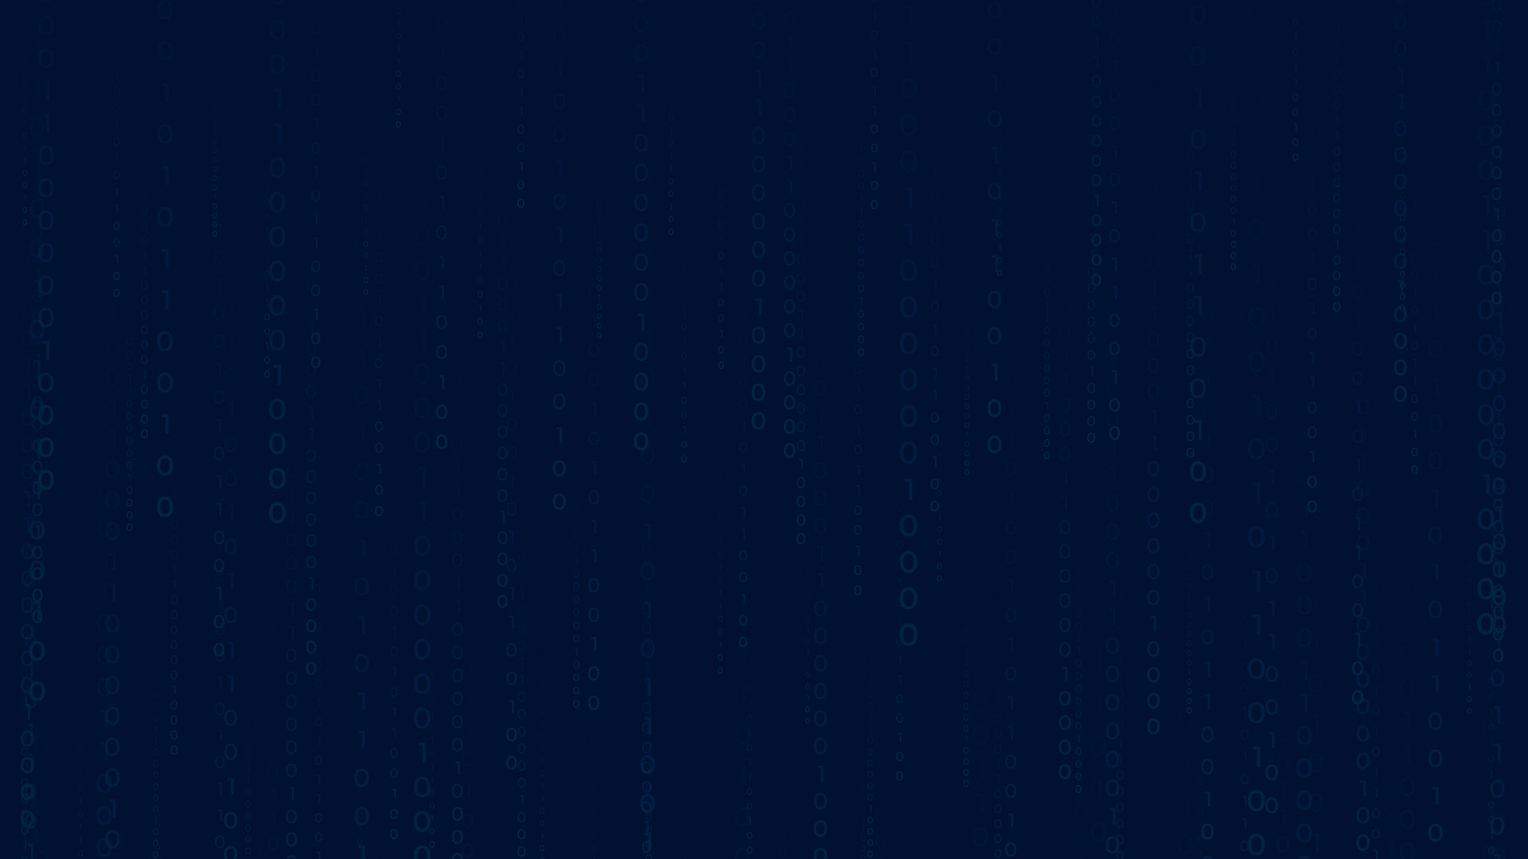
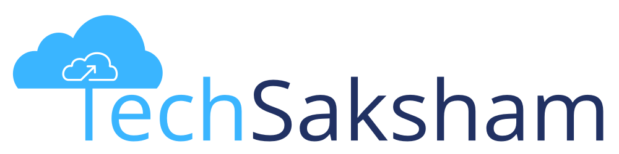
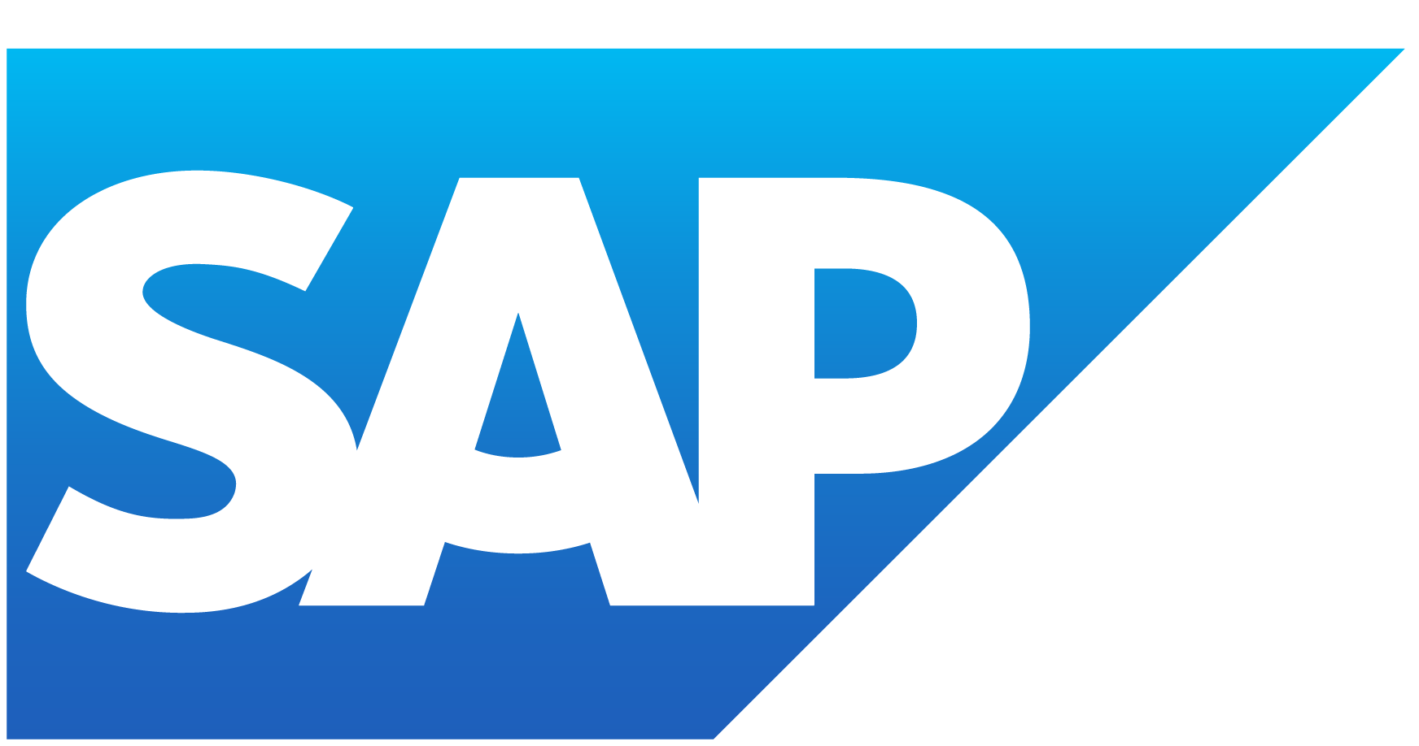


IMAGE PROCESSING USING PYTHON
Team : Vedant Parshuram Rathod Guide: Vignesh M.
Jay Anand Pyati
Vrushali Rajaram Rathod
Email: vedantrathod2123@gmail.com
Disclaimer: The content is curated for educational purposes only.
Notes:
Slides: Prepare a short slide deck (10-12 slides) summarizing the project objectives, methodology, and key results.

Slide 2
OUTLINE
Abstract of the Project
Problem Statement
Proposed Solution
System Architecture
Live Demo of the Project
Embedded Video of Project
Conclusion
Future Scope

Slide 3
Abstract
Image Processing Using NumPy. This project focuses on developing an image processing application using NumPy and Pillow (PIL) in Python.
The application allows users to load an image, apply transformations, and save the processed output. Key operations include grayscale conversion, color inversion, and blurring.
By leveraging NumPy for efficient computations, this project provides a foundation for advanced image processing tasks.
The processed images are saved for further use, making it a practical tool for beginners in computer vision.

Slide 4
Problem Statement
Inefficient Image Analysis – Traditional methods struggle with accurate image interpretation and processing.
Noise and Distortions – Images often contain noise, reducing clarity and affecting feature extraction.
Feature Extraction Challenges – Difficulty in detecting edges, contours, and key features accurately.
Slow Processing Speed – Manual or unoptimized approaches lead to longer processing times.
Lack of Structured Data Handling – Difficulty in converting image data into structured formats for analysis.
Integration Issues – Challenges in integrating processed images with machine learning models or data analytics pipelines.

Slide 5
Proposed Solution
Image Processing Using NumPy To address the problem, an image processing application is developed using NumPy and Pillow (PIL) in Python. The solution involves reading an image file, performing various transformations, and saving the processed output efficiently.
Solution Approach:Image Input & Loading:The application prompts the user to input the image file path.The image is then loaded and converted into a NumPy array for processing.
Image Processing Operations:Grayscale Conversion: Transforms the image into a black-and-white format by applying a weighted sum of RGB values.
Color Inversion: Creates a negative of the image by subtracting pixel values from 255.
Blurring Effect: Uses a Gaussian filter to smooth the image and reduce noise.
Output & Storage:The modified images are converted back into an image format.The processed images are saved locally for further use.This solution provides a simple, efficient, and beginner-friendly approach to image manipulation using NumPy, serving as a foundation for more advanced computer vision tasks.

Slide 6
System Architecture
<-- (Camera, File, Database)
<-- (Grayscale, Resize, Blur)
<-- (Edge Detection, Histogram)
<-- (NumPy, Pandas)
<-- (Matplotlib, OpenCV
<-- (Save,ML Integration)
Image Acquisition
Data Processing
Visualization and post - processing
Processing
Decision & Output
Feature Extraction

Slide 7
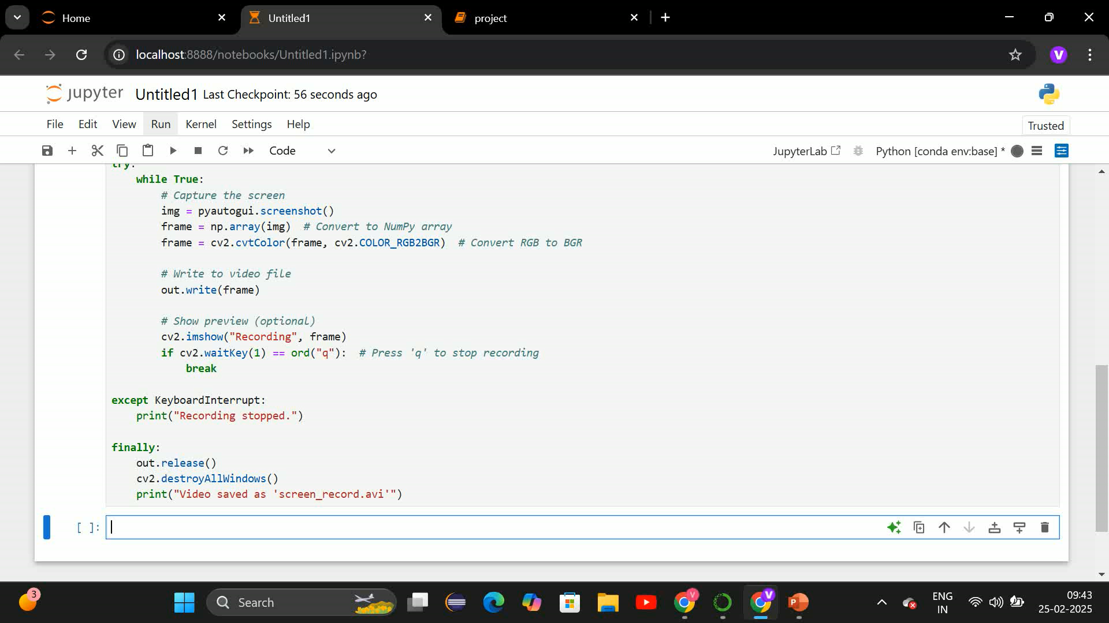
Live Demo of Project

Slide 8
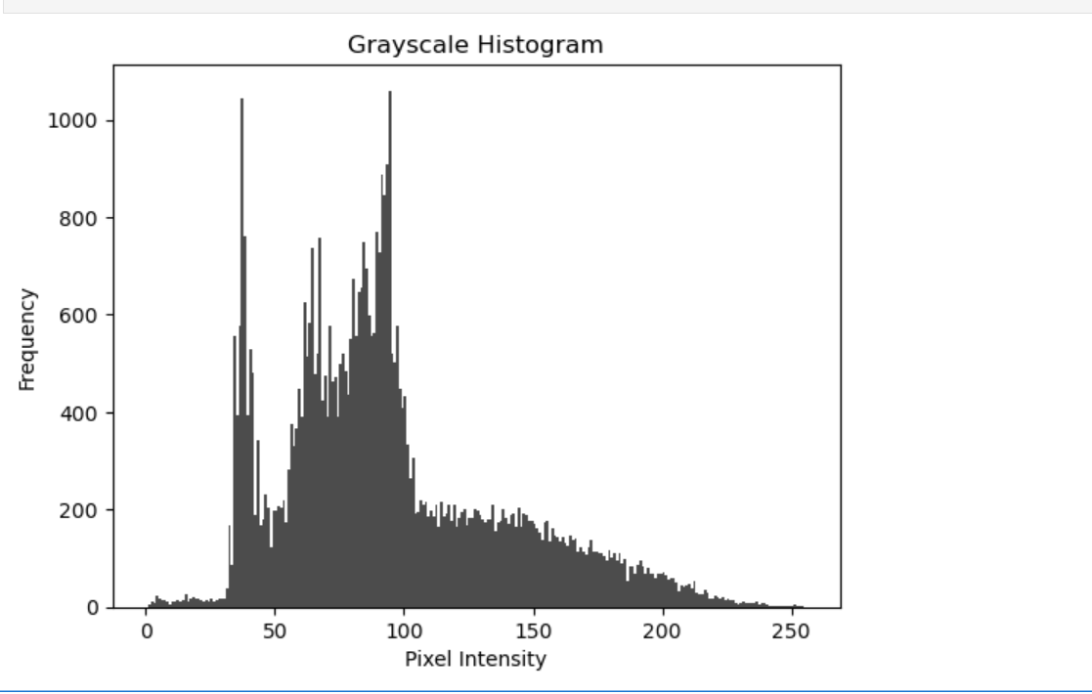
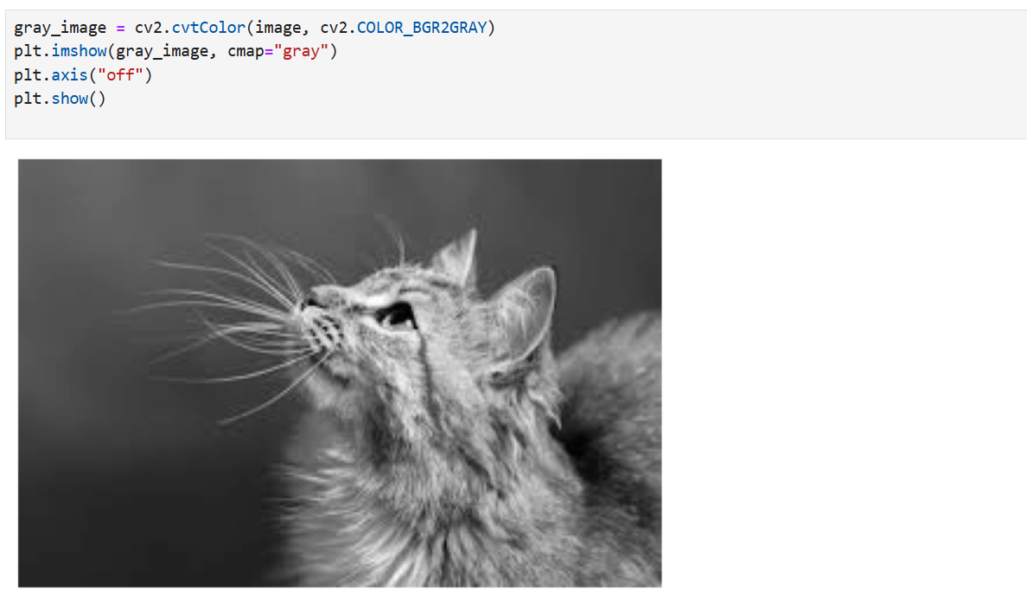
Video of Project Demo

Slide 9
Conclusion
Conclusion: This project demonstrates efficient image processing and screen recording techniques using Python.
The outputs showcase pixel-level manipulations, filtering, and video capture capabilities for further analysis.

Slide 10
Future Scope
Future Scope: Extend the implementation to real-time video processing.Use AI-based image analysis for better feature extraction.Optimize code for high-performance computing in large-scale applications.
Dual Functionality – The project combines image processing and screen recording, two essential tools for automation and analytics.
Real-World Applications – These techniques are used in surveillance, computer vision, and digital forensics.
Live Data Visualization – The project allows users to analyze images in real-time using histograms and pixel intensity distributions.
AI & ML Ready – The processed images can be further used for training deep learning models in object detection and facial recognition.
Cross-Platform Compatibility – Works on Windows, macOS, and Linux, making it accessible to all developers.

Slide 11
Thank you!
Notes:
thank you very much for joining this PPT, keep learning.
11

